Slide 1
ASP.Net Core – Getting Started
Kamal Beydoun
Lebanese University – Faculty of Sciences I
Kamal.beydoun@ul.edu.lb

Slide 2
Introduction
ASP.NET Core is the latest evolution of Microsoft’s popular ASP.NET web framework
released in June 2016.
focusing on high developer productivity and prioritizing backwards compatibility.
ASP.NET Core bucks that trend by making significant architectural changes that rethink the way the web framework is designed and built.

Slide 3
Introduction
ASP.NET Core makes writing web applications faster, easier, and more secure.
It contains libraries for common things like:
Creating dynamically changing web pages
Letting users log in to your web app
Letting users use their Facebook account to log in to your web app using OAuth
Providing a common structure to build maintainable applications
Reading configuration files
The key to any modern web application is the ability to generate dynamic web pages.
Notes:
A dynamic web page displays different data depending on the current logged-in user, for example, or it could display content submitted by users.

Slide 4
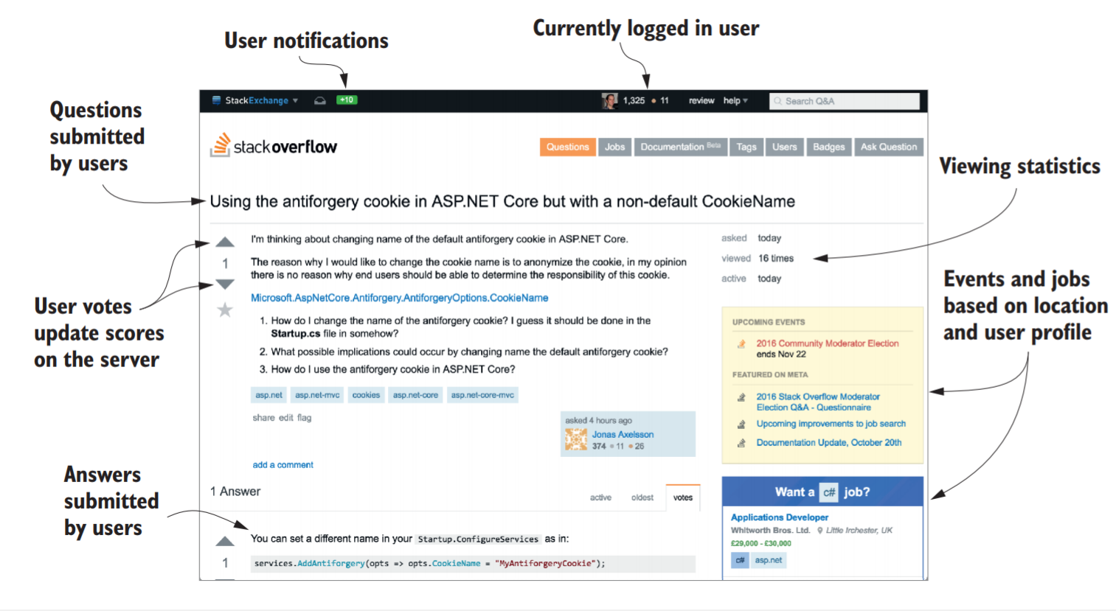
Introduction
The Stack Overflow website (http://stackoverflow.com) is built using ASP.NET and is almost entirely dynamic content.

Slide 5
ASP.NET
ASP.NET Web Forms
create web applications using a graphical designer and a simple event model. ☺
lack of testability, a complex stateful model (making client-side development difficult). ☹
Microsoft released the first version of ASP.NET MVC in 2009, based on the Model-View-Controller pattern.
Notes:
Stateful means the computer or program keeps track of the state of interaction, usually by setting values in a storage field designated for that purpose. Stateless means there is no record of previous interactions and each interaction request has to be handled based entirely on information that comes with it.
MVC a common web design pattern used in other frameworks such as Ruby on Rails, Django, and Java Spring.

Slide 6
What is ASP.NET Core?
Is a lightweight platform that runs on Windows, Linux, and macOS.
Shares many of the same APIs as .NET Framework, but it’s smaller.
Provides a simpler implementation and programming model.
It’s a completely new platform, rather than a fork of .NET Framework, though it uses similar code for many of its APIs.
Notes:
currently only implements a subset of the features of .Net Framework

Slide 7
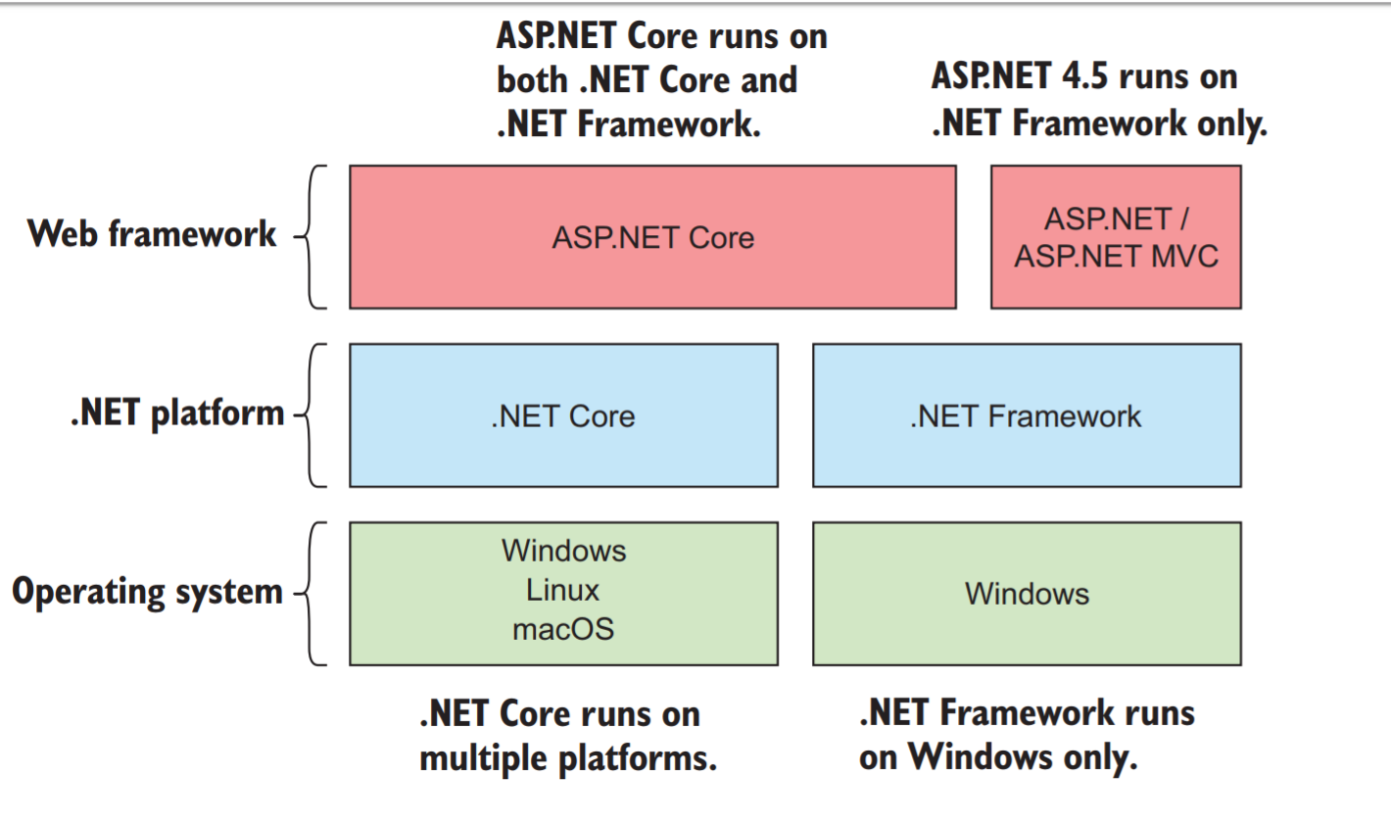
What is ASP.NET Core?

Slide 8
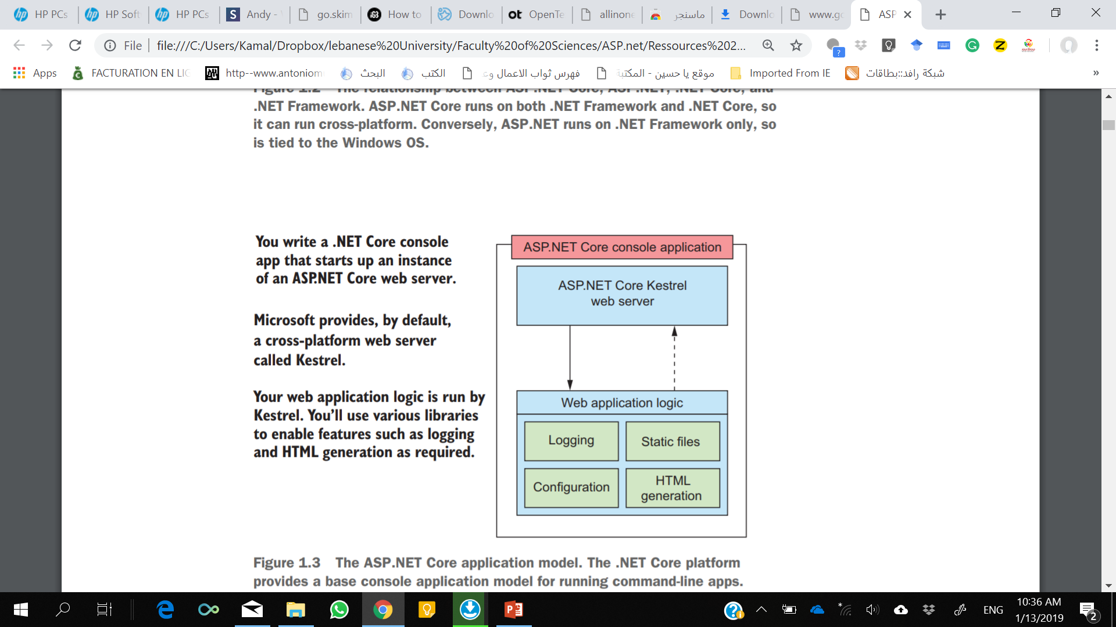
What is ASP.NET Core?
Most of the libraries you’ll use in ASP.NET Core can be found on GitHub : https://github.com/aspnet

Slide 9
What type of applications can you build?
Server-side-rendered web applications are the bread and butter of ASP.NET development.
Single-Page Applications (SPAs), which use a client-side framework that commonly talks to a REST server, are easy to create with ASP.NET Core.
Whether you’re using Angular, Ember, React, or some other client-side framework, it’s easy to create an ASP.NET Core application to act as the server-side API.
Notes:
Representational State Transfer (REST) is a software architectural style that defines a set of ... In aRESTful Web service, requests made to a resource's URI will elicit a response with a payload formatted in HTML, XML, JSON, or some other ...
SPA is a web app that interacts with the user by dynamically rewriting the current page rather than loading entire new pages from a server.

Slide 10
If you’re new to .NET development
ASP.NET Core has many selling points when compared to other cross-platform web frameworks:
It’s a modern, high-performance, open source web framework.
It uses familiar design patterns and paradigms.
C# is a great language (or you can use VB.NET or F# if you prefer).
Notes:
Many of the web frameworks available today use similar, well-established design patterns, and ASP.NET Core is no different. For example, Ruby on Rails is known for its use of the Model-View-Controller (MVC) pattern; Node.js is known for the way it processes requests using small discrete modules (called a pipeline); and dependency injection is found in a wide variety of frameworks. If these techniques are familiar to you, you should find it easy to transfer them across to ASP.NET Core; if they’re new to you, then you can look forward to using industry best practices!

Slide 11
If you’re new to .NET development
The primary language of .NET development, and ASP.NET Core in particular, is C#.
It provides a sense of familiarity to those used to C, Java, and many other languages.
It has many powerful features, such as Language Integrated Query (LINQ) and asynchronous programming constructs.

Slide 12
Compile-once, Run-anywhere
As well as running on each platform, one of the selling points of .NET is the ability to write and compile only once.
Your application is compiled to Intermediate Language (IL) code, which is a platform-independent format.
If a target system has the .NET Core platform installed, then you can run compiled IL from any platform.

Slide 13
Main ASP.NET Core benefits
Cross-platform development and deployment
A focus on performance as a feature
A simplified hosting model
Regular releases with a shorter release cycle
Open source
Modular features
Notes:
The main benefits over the previous ASP.NET framework are

Slide 14
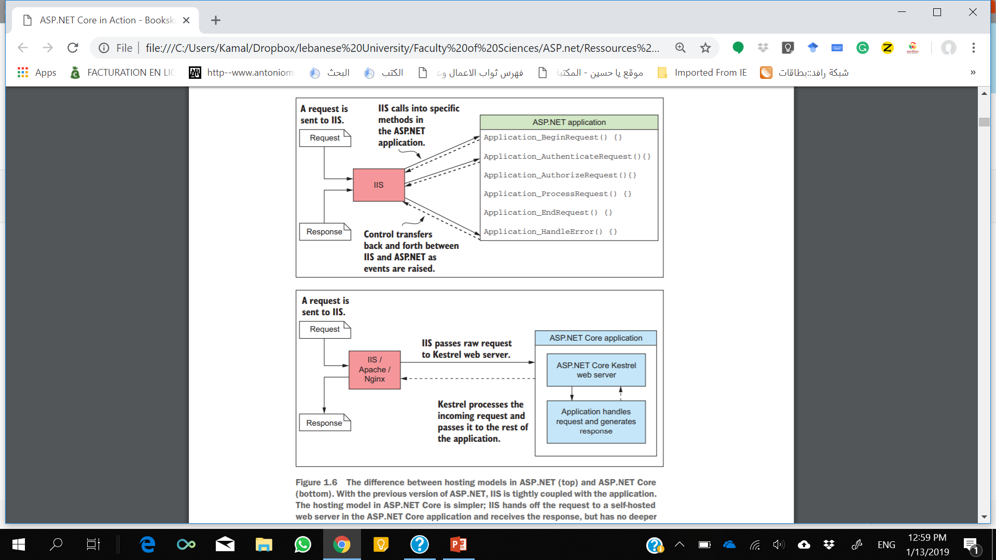
Hosting in ASP.NET and ASP.NET Core
To be competitive cross-platform, the ASP.NET team have focused on making the Kestrel HTTP server as fast as possible.
Notes:
The difference between hosting models in ASP.NET (top) and ASP.NET Core (bottom). With the previous version of ASP.NET, IIS is tightly coupled with the application. The hosting model in ASP.NET Core is simpler; IIS hands off the request to a self-hosted web server in the ASP.NET Core application and receives the response, but has no deeper knowledge of the application.

Slide 15
NuGet
The entire web framework is implemented as NuGet packages
NuGet is a package manager for .NET that enables importing libraries into your projects.

Slide 16
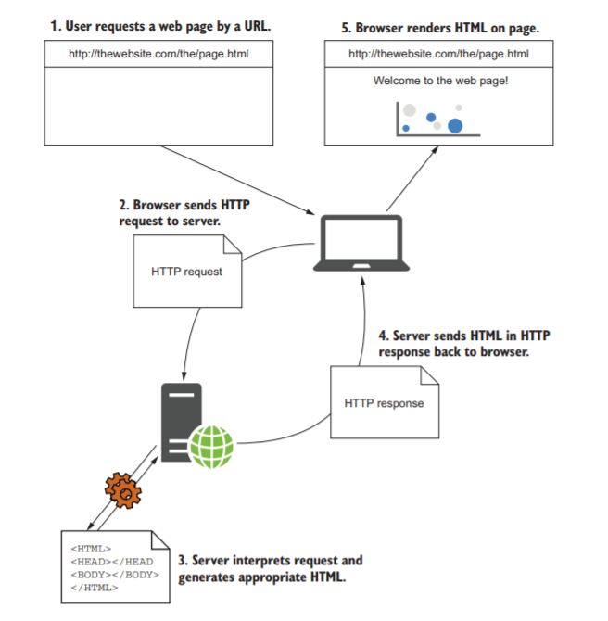
How does ASP.NET Core work?
Notes:
Requesting a web page. The user starts by requesting a web page, which causes an HTTP request to be sent to the server. The server interprets the request, generates the necessary HTML, and sends it back in an HTTP response. The browser can then display the web page.

Slide 17
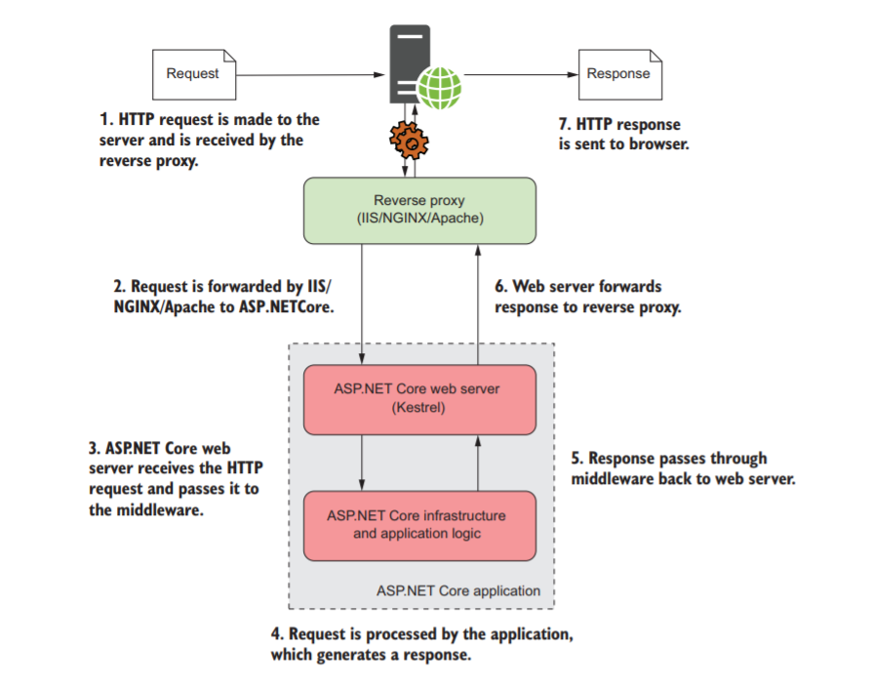
How does ASP.NET Core process a request?
Notes:
The request is forwarded from the reverse proxy to your ASP.NET Core application.
Every ASP.NET Core application has a built-in web server, Kestrel by default, which is responsible for receiving raw requests and constructing an internal representation of the data, an HttpContext object, which can be used by the rest of the application.
From this representation, your application should have all the details it needs to create an appropriate response to the request.
It can use the details stored in HttpContext to generate an appropriate response, which may be to generate some HTML,
to return an “access denied” message, or to send an email, all depending on your application’s requirements.

Slide 18
.Net Framework vs .Net Core
You can build and run an ASP.NET Core application on both .NET Core or .NET Framework.
.NET Core : The cross-platform and container-friendly.
Your app relies on many Windows-only features, then .NET Framework may be the easiest option.
.NET Framework is that it has the greatest library support, in the form of NuGet packages.
The open source nature of .NET Core development can be a big deciding factor for some people.
The highly modular design of .NET Core, it’s likely that the platform will see a faster release cycle than other platforms.
.NET Core also follows semantic versioning (SemVer), so you can be sure that your old applications won’t be affected by installing a new version of the framework.
Notes:
Library authors are being encouraged to make their libraries work identically on both .NET Framework and .NET Core by targeting .NET Standard, but that transition is a slow process.
.NET Standard7 defines the APIs that are available on a given .NET platform. It’s made up of multiple versions (for example, 1.1 and 1.2), each of which adds additional APIs compared to previous versions. Think of it as an “interface” for various .NET frameworks; the frameworks (such as .NET Core, .NET Framework, and Mono) all “implement” a version of .NET Standard.

Slide 19
Preparing your development environment
All of ASP.NET Core (creating new projects, building, testing, and publishing) can be run from the command line for any supported operating system.
All you need is the .NET Core SDK and tooling, which provides the .NET Command Line Interface (CLI).
Notes:
For .NET developers in a Windows-centric world, Visual Studio was pretty much a developer requirement in the past. But with .NET Core and ASP.NET Core going cross-platform, that’s no longer the case.

Slide 20
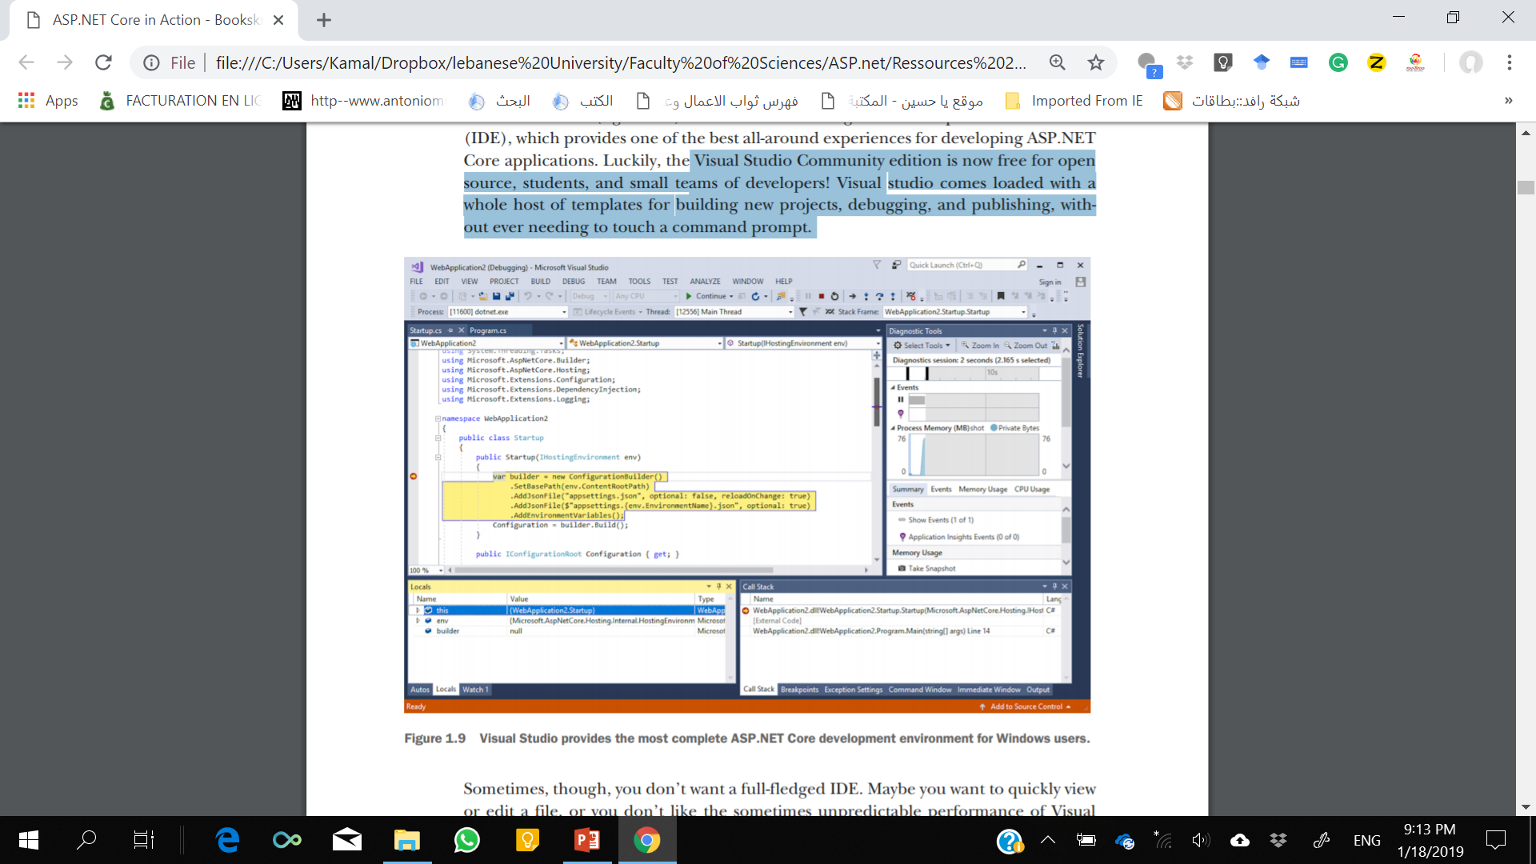
Visual Studio
Visual Studio is a full-featured integrated development environment (IDE), which provides one of the best all-around experiences for developing ASP.NET Core applications.
Notes:
Visual Studio Community edition is now free for open source, students, and small teams of developers! Visual studio comes loaded with a whole host of templates for building new projects, debugging, and publishing, without ever needing to touch a command prompt.

Slide 21
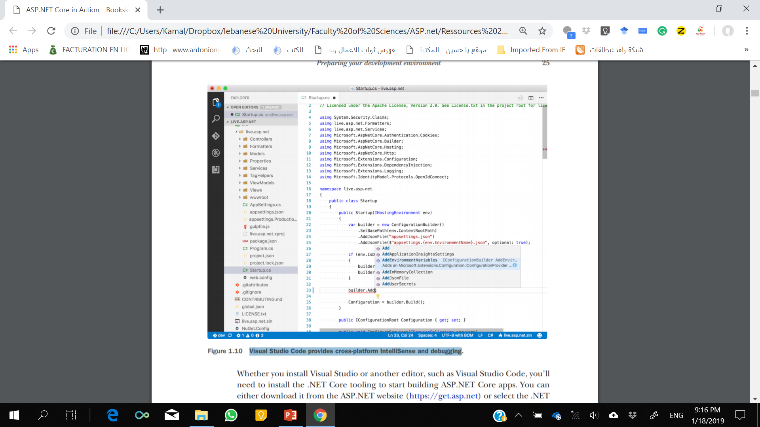
Visual Studio Code
Visual Studio Code provides cross-platform IntelliSense and debugging
Notes:
you don’t want a full-fledged IDE. Maybe you want to quickly view or edit a file, or you don’t like the sometimes unpredictable performance of Visual Studio. In those cases, a simple editor may be all you want or need, and Visual Studio Code is a great choice. Visual Studio Code (figure 1.10) is an open source, lightweight editor that provides editing, IntelliSense, and debugging for a wide range of languages, including C# and ASP.NET Core.

Slide 22
.Net SDK and tooling
Whether you install Visual Studio or another editor, such as Visual Studio Code, you’ll need to install the .NET Core tooling to start building ASP.NET Core apps.
You can either download it from the ASP.NET website (https://get.asp.net) or select the .NET Core cross-platform development workload during Visual Studio 2017 installation.

Slide 23
Summary
ASP.NET Core is a new web framework built with modern software architecture practices and modularization as its focus.
It’s best used for new, “green-field” projects with few external dependencies.
Existing technologies such as WCF and SignalR can’t currently be used with ASP.NET Core, but work is underway to integrate them.
Fetching a web page involves sending an HTTP request and receiving an HTTP response.

Slide 24
Summary
ASP.NET Core allows dynamically building responses to a given request.
An ASP.NET Core application contains a web server, which serves as the entrypoint for a request.
ASP.NET Core apps are protected from the internet by a reverse-proxy server, which forwards requests to the application.
ASP.NET Core can run on both .NET Framework and .NET Core. If you need Windows-specific features such as the Windows Registry, you should use .NET Framework, but you won’t be able to run cross-platform. Otherwise, choose .NET Core for the greatest reach and hosting options.
The OmniSharp project provides C# editing plugins for many popular editors, including the cross-platform Visual Studio Code editor.
On Windows, Visual Studio provides the most complete all-in-one ASP.NET Core development experience, but development using the command line and an editor is as easy as on other platforms.

